Slide 1

Measured Impact of factors affecting PM2.5 Concentrations
Alexander nguyen

Slide 2
Experimental Design
Factors Analyzed:
Urban Background Concentration – Rubidoux
Meteorological Conditions
Temperature
Air Pressure
Humidity
Wind Speed
Wind Direction
Local Traffic Conditions
Traffic Density

Slide 3
Gradient Boosted Regression Tree
An advanced form of regression tree machine learning algorithm that uses a validation step to measure the weights of different variables and finetunes the model
In Short: Capable of measure the impact of features

Slide 4
Model Setup and Parameters
Data Split:
80/10/10
Loss Function:
Huber loss (combined squared error and absolute error)
Learning rate:
0.001
Number of Boosting Stages:
9000 Stages
Split Criterion:
Friedman MSE

Slide 5
Data Sources
Traffic Density
Freeway Traffic Flow: PEMS
Avg. Speed: Google Maps API
Local Traffic Flow: GridSmart
Background PM2.5
CARB: Rubidoux (Resampled - Forward Filled)
Local PM2.5
Clarity Monitor
Data Points
2991

Slide 6
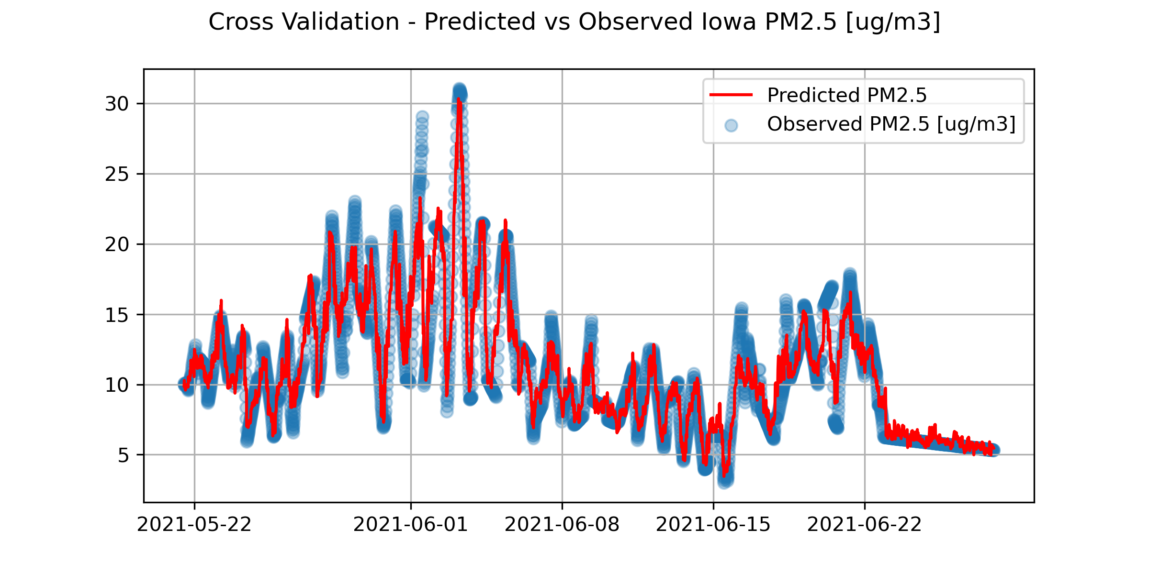
Cross Validation Scores
Avg. Test R2: 0.92
Avg. Test MSE: 1.97
Avg. Test RMSE: 1.40
Avg. Test Explained Variance: 0.916

Slide 7

Partial Dependence
The partial function tells us for given values of features S what the average marginal effect on the prediction is
Xs = feature value we are interested in
Xc = feature values we are not interested in
N = number of instances in the dataset

Slide 8
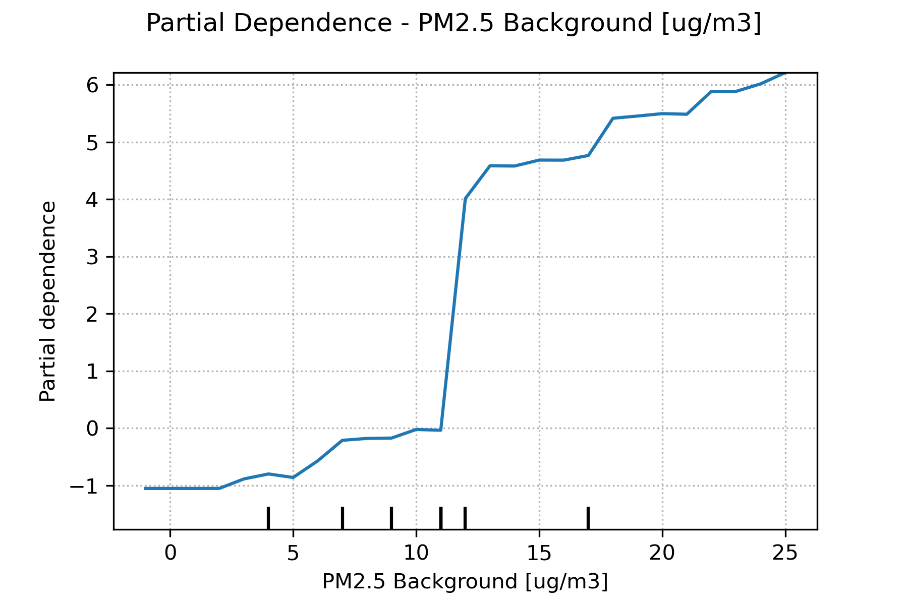
Partial Dependence for Background

Slide 9
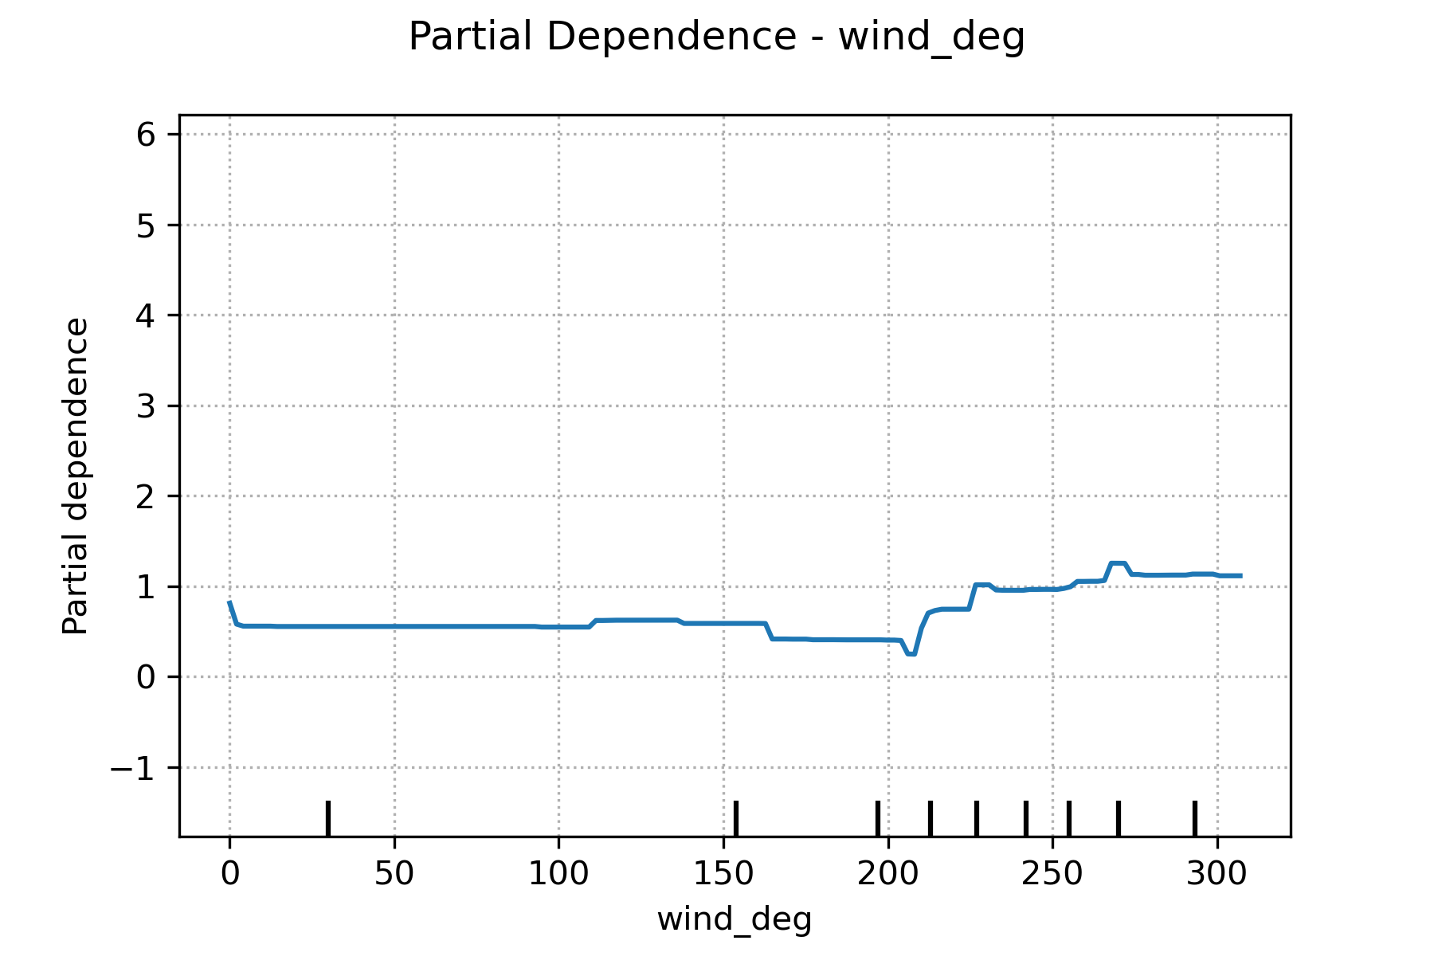
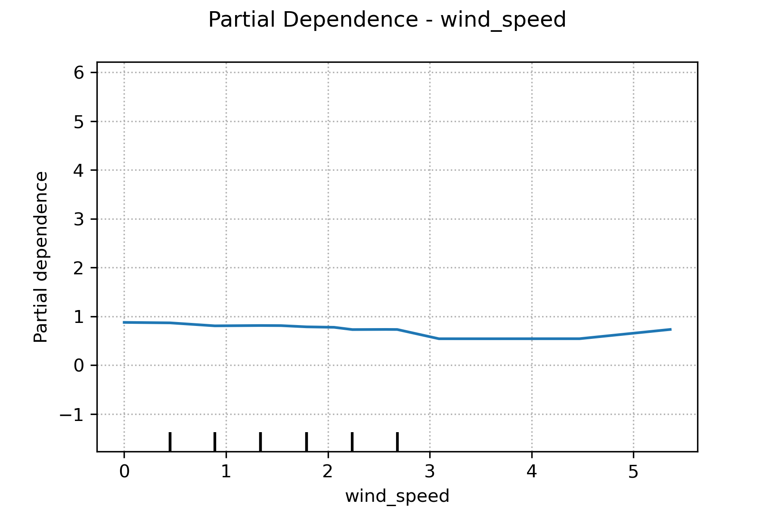
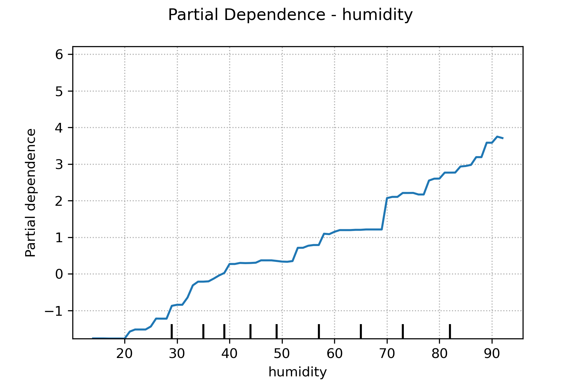
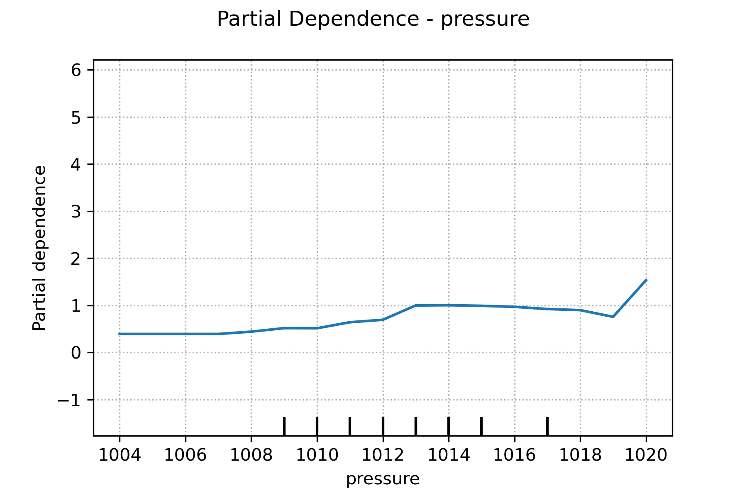
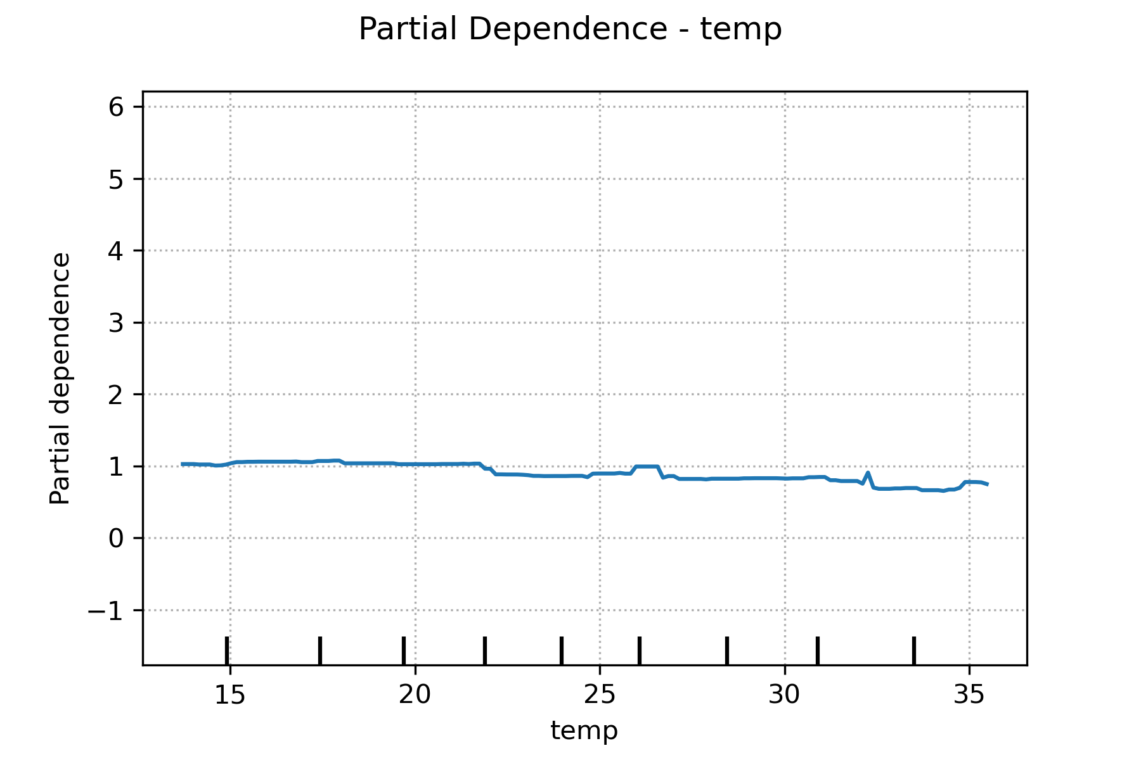
Partial Dependence for Meteorological Conditions

Slide 10
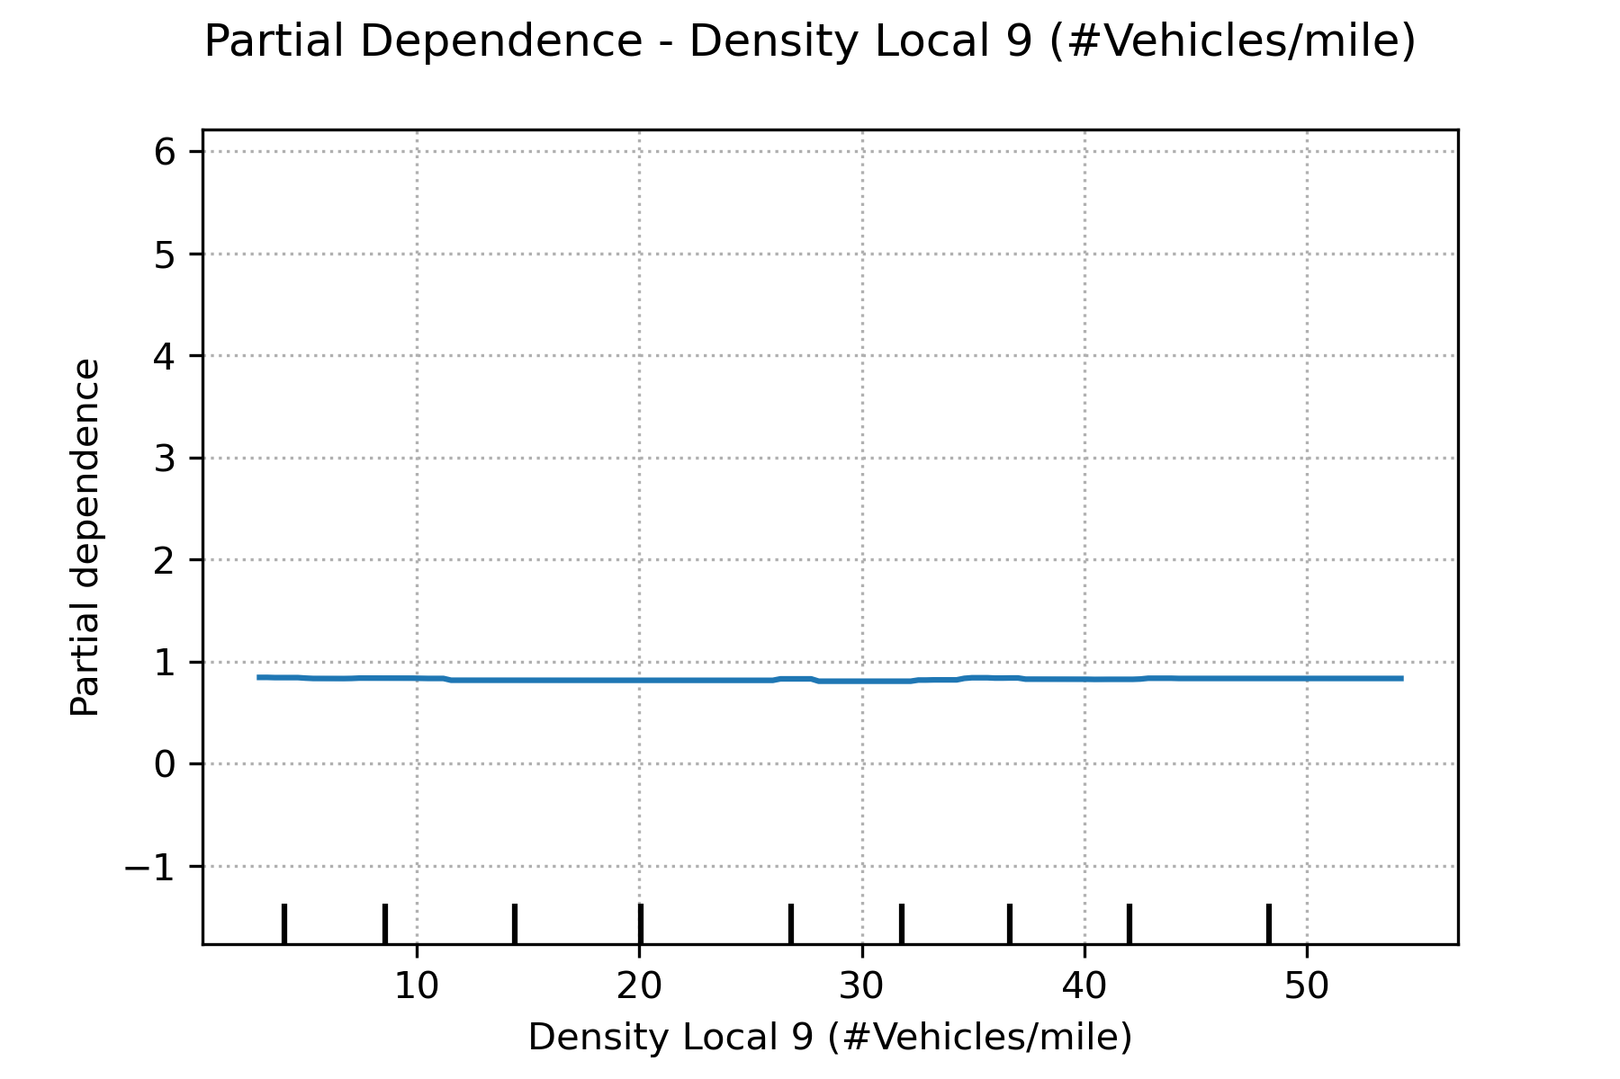
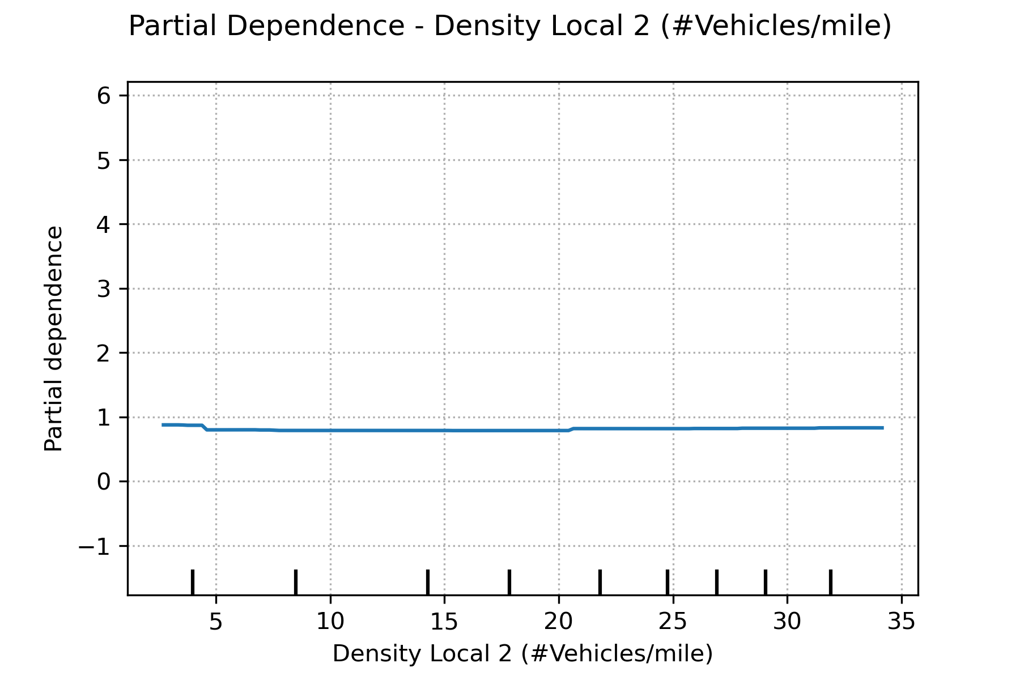
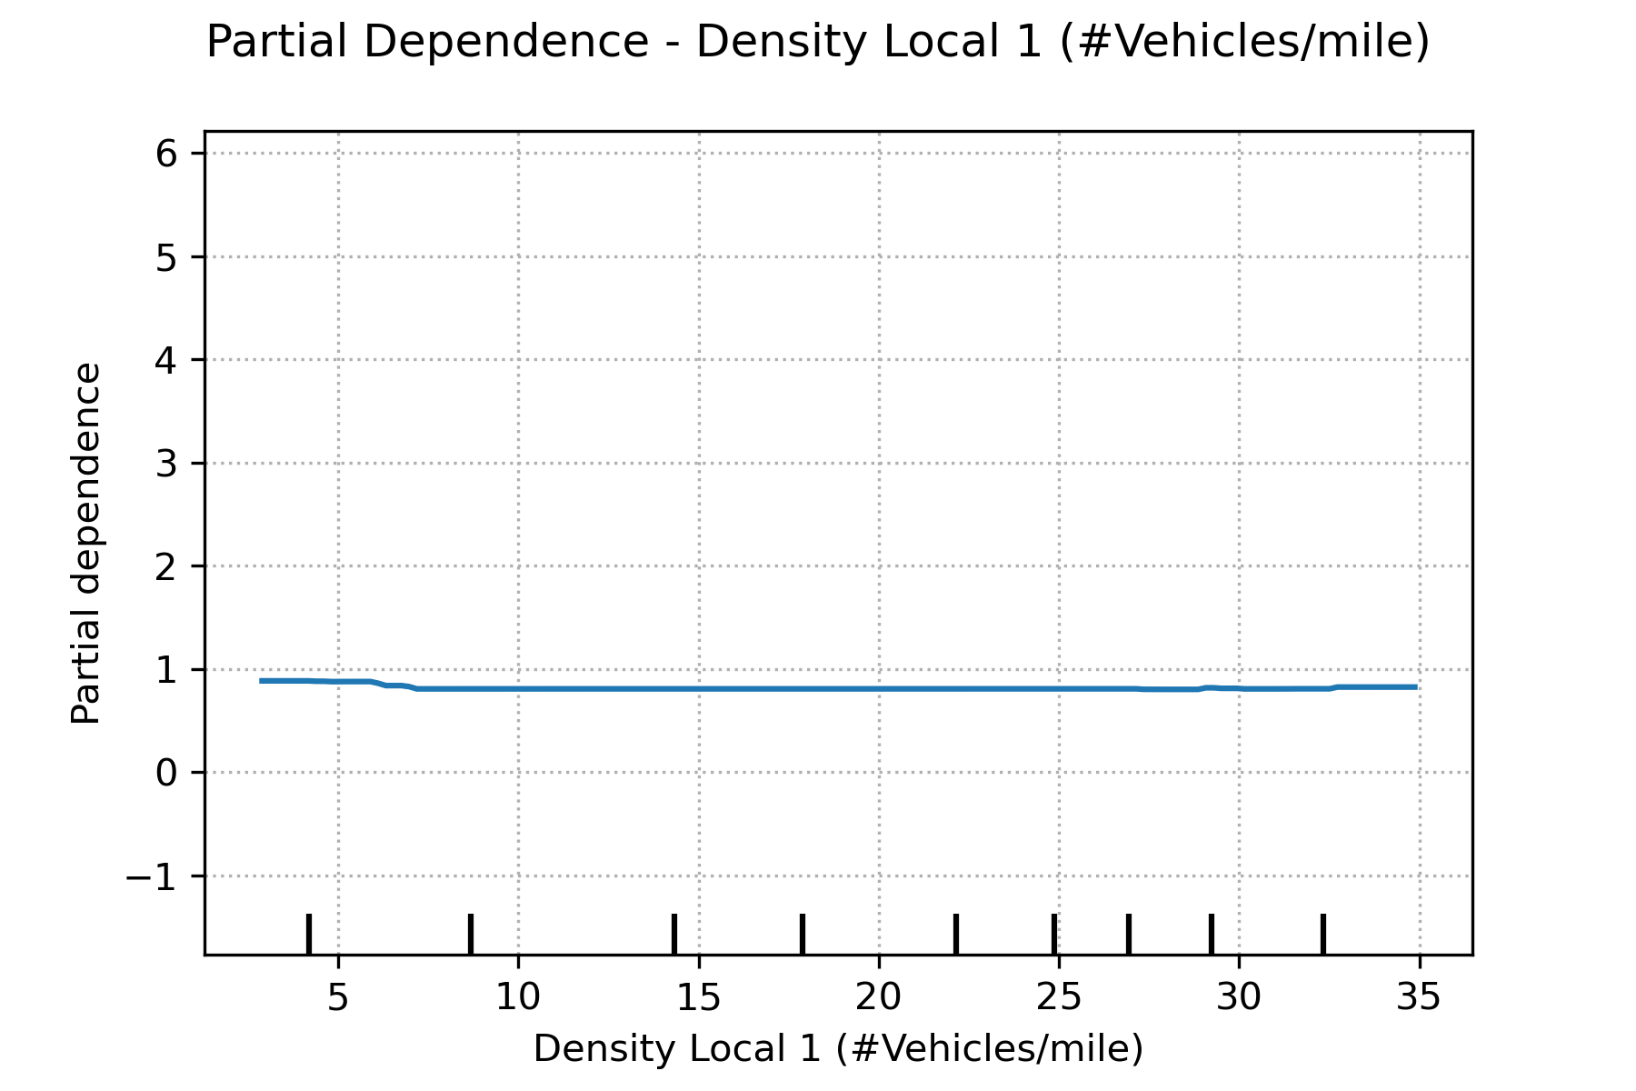
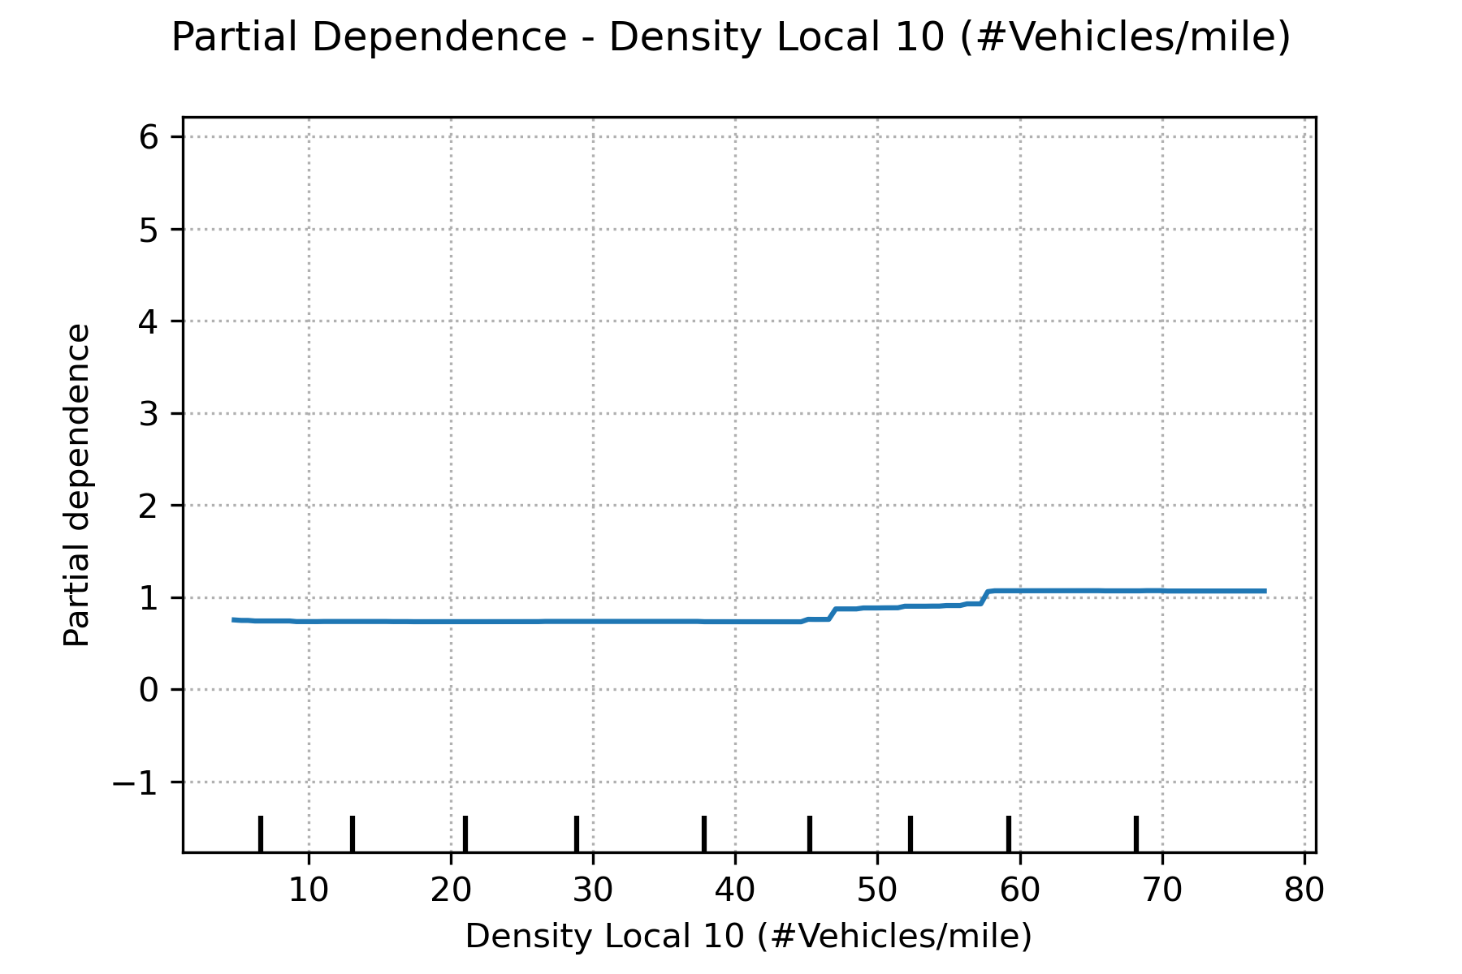
Partial Dependence - Traffic Conditions

Slide 11
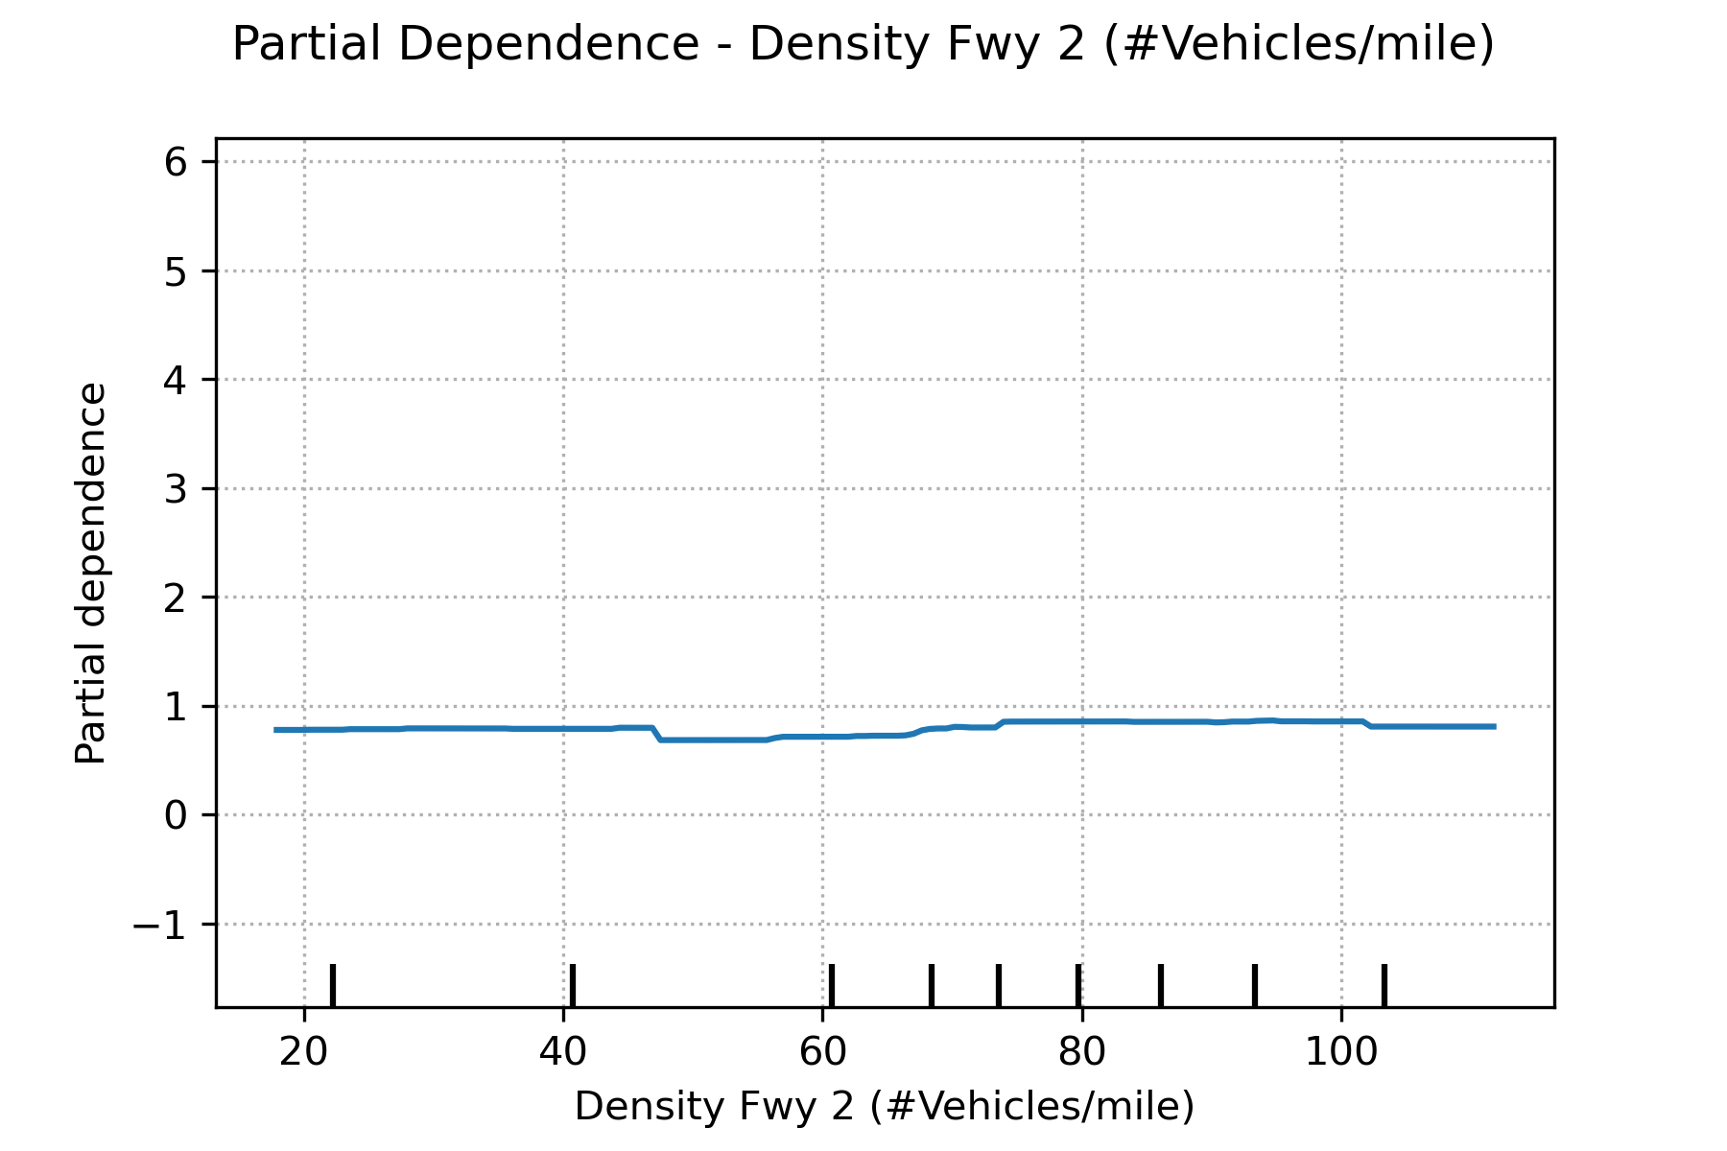
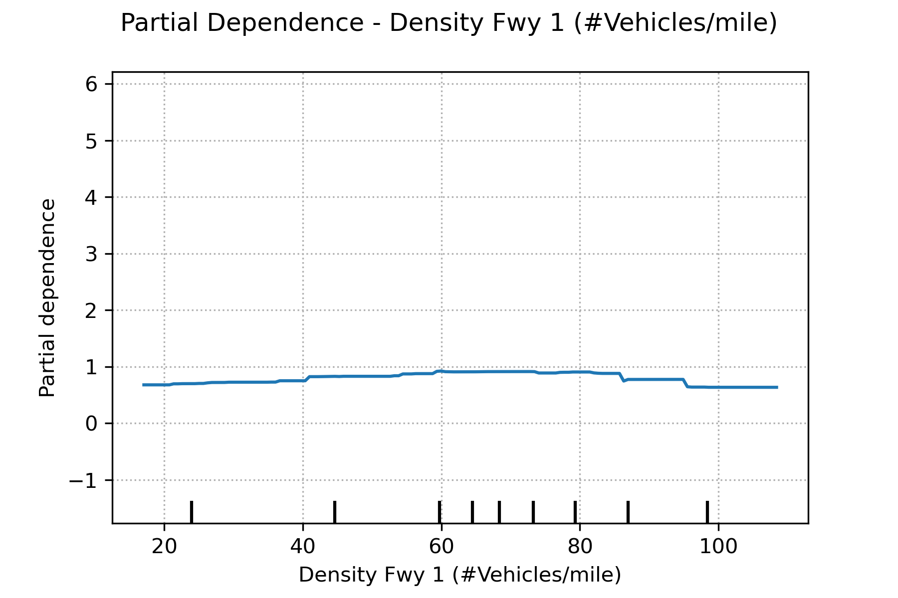
Partial Dependence – Freeway Traffic Conditons

Slide 12
Limitations
Amount of data does not span the entire year

